Slide 1
SmartWalker
Critical Design Review
Group 16
Mike Orr
Loc Truong
Dang Khoa Le

Slide 2
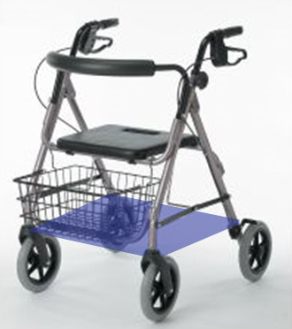
SmartWalker
Mechanical Break
Convenience Basket
Platform for motor mounting
PCB enclosure, Battery

Slide 3
Motivation
Interested in robotics and wireless control
To create a useful product

Slide 4
Goals and Objectives
Assist in day-to-day activity of user
Alert the user of obstacles
Be able to control SmartWalker on a computer via WiFi
Video Streaming to PC
Reliable
Battery over-charging protection
Low cost

Slide 5
Specifications
Be able to move while holding a load of up 40 pounds
Be able to communicate with remote controller up to a distance of 150 meters
Move no faster than 10 RPM

Slide 6

Task Distribution
Loc
DK
RF Transmitter Module
RF Receiver Module
Mike
Microcontroller
Motor Controls
L
Microcontroller
R
WiFi Module
Camera
Computer App
Power Supply

Slide 7
Overall System Block Diagrams

Slide 8
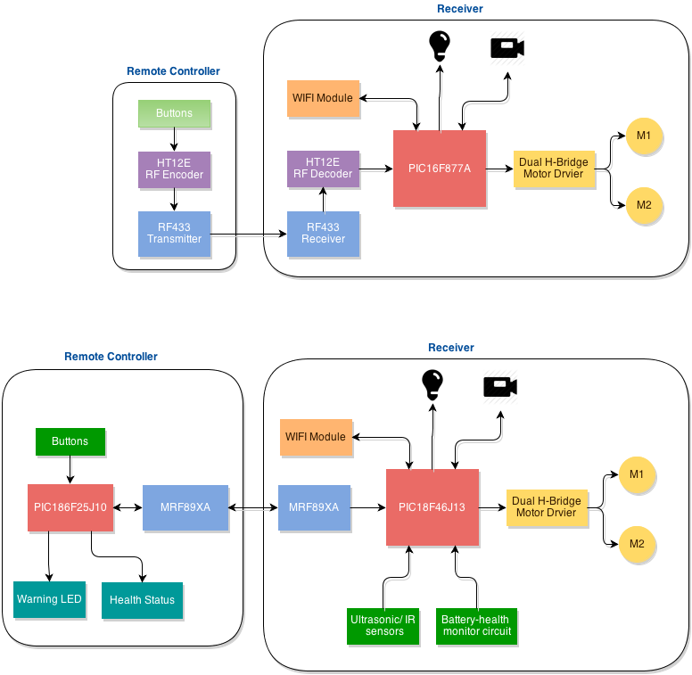
Design 1 Block Diagram

Slide 9
Design 2 Block Diagram

Slide 10
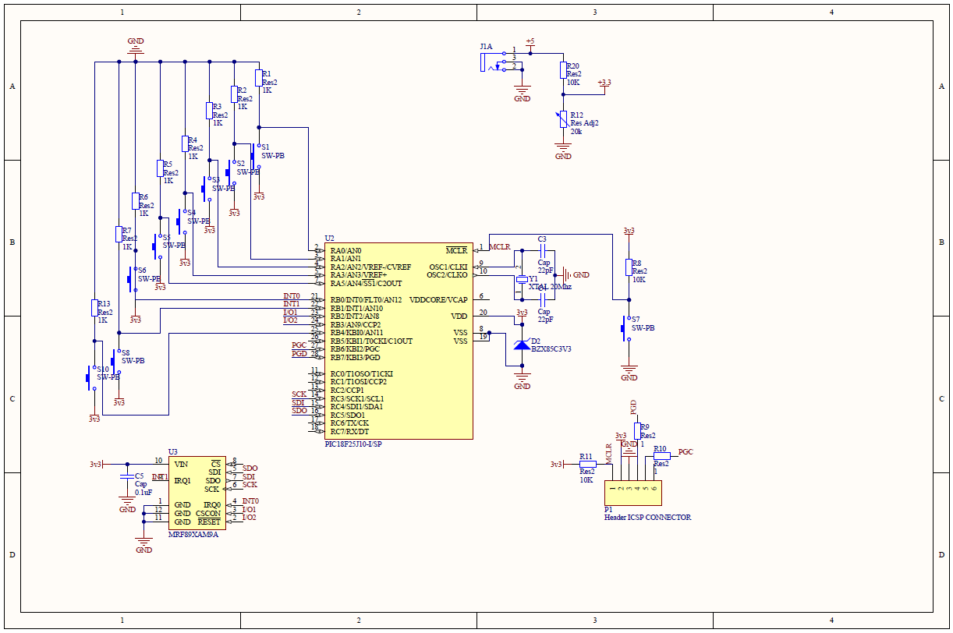
Remote Controller Schematic
PIC18F25J10
MRF89XAM9A RF Transceiver

Slide 11
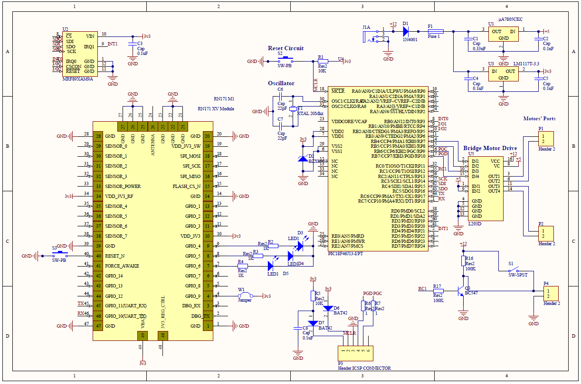
Receiver Schematic
Power Supply
MRF89XAM9A RF Transceiver
PIC18F46J13
Motor Driver
RN171 XV WIFI

Slide 12
Sub-systems

Slide 13
Motors and Motor Controller
Motor Controller
Left Motor
Right Motor

Slide 14
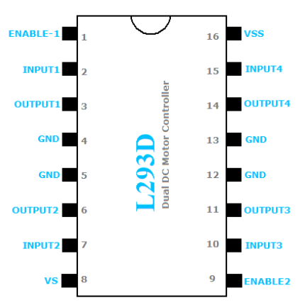
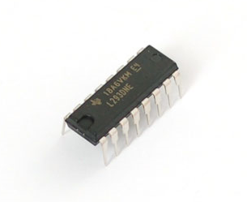
Motor Controller
Using Bridge Motor Drive L293D (16 PIN chip)
Cost : $2.50. Used for DC or Stepper Motor

Slide 15
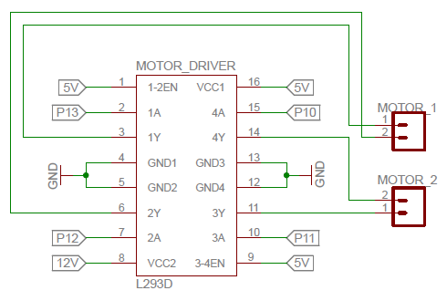
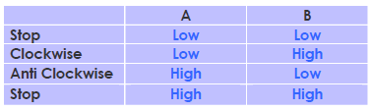
L293D with Motors

Slide 16
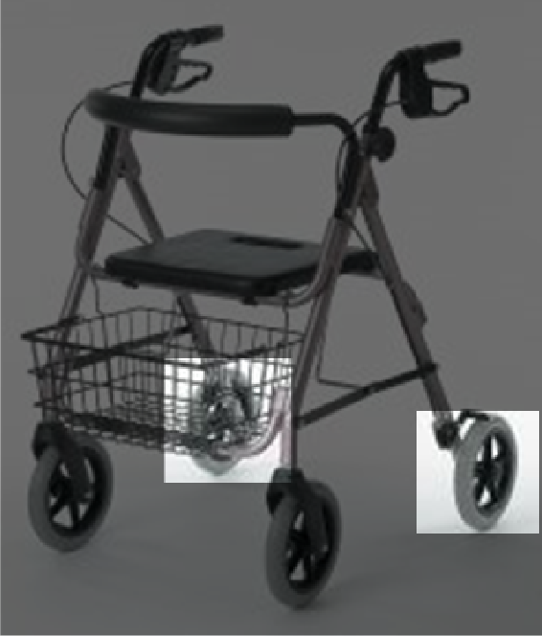
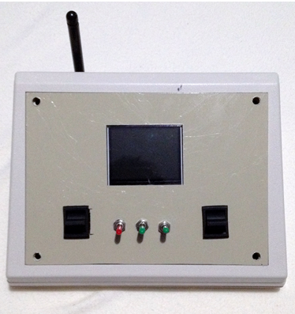
Driving Method
Forward and Backward
Turning left and right

Slide 17
Specifications desired for motors
Produce high torque.
Have reasonable turn speed.
Require 12V DC (to be compatible with system voltage supplier).
Generates low current to reduce heat.
Low cost.

Slide 18
Motor Choices (DC Motor)
Motor Names | Voltage (V) | Current (A) | Torque (N*m) | RPM | Cost (USD/piece)
Electric Gear Motor | 12 | 3-15 | 11.5 | 50 | 59.99
63ZYT01C DC Motor | 24 | 4.5 | 1.3 | 2800 | 18
Leeson M1135246 | 12 | 0.23 | 17.51 | 83 | 347

Slide 19
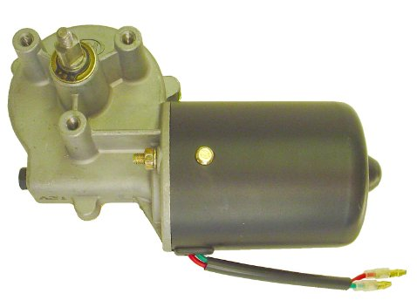
Motor control options :
 | ON/OFF switch | Momentary switch | Latch Switch
Voltage source | 12 V | 12 V | 12 V
Current rating | 15 A | 3 A | 3 A
Control method | On - Off | Hold right : turn Release : stop Hold left : turn opposite direction Release : stop | Press right : turn Press right : stop Press left : turn opposite direction Press left : stop

Slide 20
Motor Parts
L293D Motor Driver
Electric Gear Motor(Left)
Electric Gear Motor(Right)

Slide 21
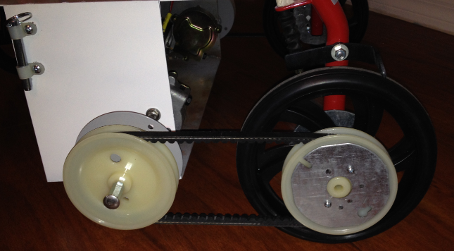
Motor – Wheels connection
Motors connect to small discs.
Pulleys connects to the fixed-wheels using low-tension belts.
Small pins are used switch from remote control to manual use.
When using remote, the pins will connect the motors to the plastic pulleys.

Slide 22
RF Modules
Considering 2 options:
RF433 transmitter, receiver
Microchip MRF89XAM9A: RF Transceiver
Parameter | RF433 Tx/Rx Module | RF Transceiver MRF89XAM9A
Frequency Range | 433.92MHz | 902-928MHz
Operating Voltage | 3-12V (5V typical) | 2.1-3.6V (3.3V typical)
External Antenna Circuit Required | Yes | No
Operating Range | Up to 300m | 300-500m
Output Power | 16dBm (40mW) | +10dBm (10mW)
Communication | 1-way | 2-way

Slide 23
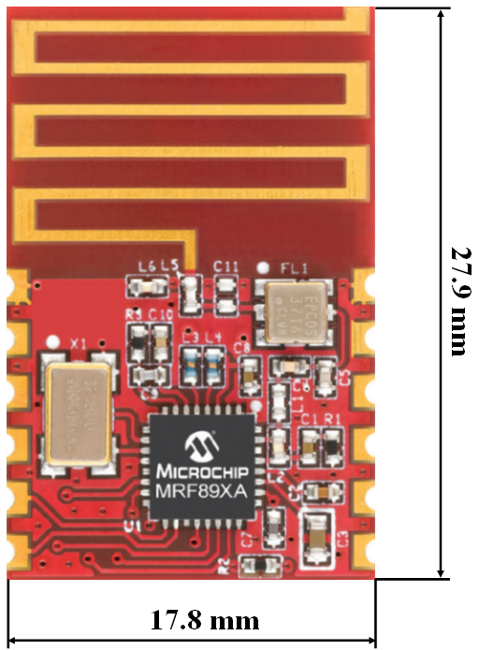
MRF89XAM9A: RF Transceiver
ISM Band 902-928 MHz operation
2.1V-3.6V operating voltage
Ultra-low current consumption:
Rx mode: 3 mA (typical)
Tx mode: 25 mA at 10dBm (typical)
Sleep mode: 0.1µA (typical)
Interface with microcontroller via 4-wire SPI with interrupts
Easy integration into final product
Fully compatible with PIC MCUs
How-to supporting documents, reference design, libraries…can be easily obtained on micrcochip.com
*A quarter diameter is 24.26 mm

Slide 24
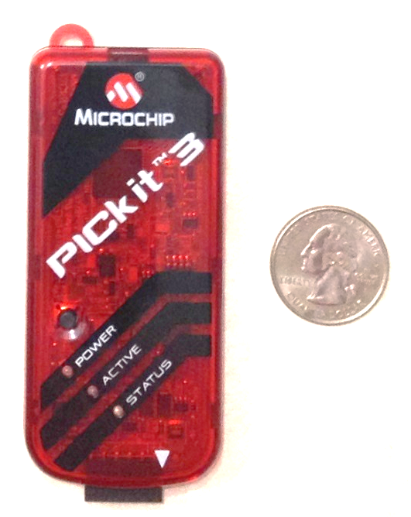
Microcontroller
PIC microcontroller from Microchip:
The main components used are from Microchip
Already owned a PICKit 3 In-Circuit Programmer/Debugger.
Program/reprogram any PIC MCU via 4-wire SPI
USB connection from the programmer to PC
Familiar with PIC programming
Resources and information available
Applications, libraries, and supports also available microchip.com

Slide 25
PIC Microcontrollers
Parameter | PIC18F46J13 (Receiver) | PIC18F25J10 (Controller)
Program Mem.Type | Flash | Flash
Program Memory | 64 KB | 32 KB
RAM | 3800 Bytes | 1024 Bytes
PWM | 1,2 or 4 | 1,2 or 4
Comm. Peripherals | 2-UART, 2- SPI | 1-UART, 1-SPI
Operating Voltage | 2V-3.6V | 2V-3.6V
CPU Speed | 12 MIPS | 10 MIPS
ADC | 13 channels 12-bit | 10 channels 10-bit
Timers | 4x8 bit, 4x16 bit | 1x8-bit, 2x16-bit
Price | $4.16/unit | $1.99/unit
Requires:
Total 4 PWM for the drive sub-system: 2 PWM for each motor
Interface with WIFI and RF module through UART and SPI, respectively
WIFI and RF module support 3.3V High Logic Voltage Pin
Require high performance: memory sufficiency, high speed, good timer resolution…)

Slide 26
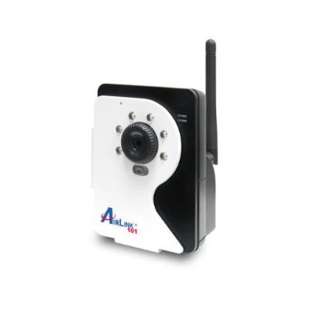
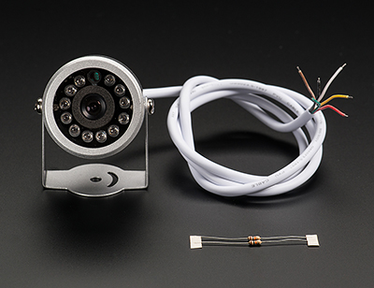
Camera
IP
Transmits video via WIFI or Ethernet
Easier to mount
More expensive
Serial
Transmits video
Cheaper
Harder to mount
Notes:
1st camera, ~$60 used on amazon: Airlink101 AICN500W SkyIPCam500W Wireless Night Vision Network Camera
2nd camera, ~$55: Weatherproof TTL Serial JPEG Camera with NTSC Video and IR LEDs

Slide 27
Camera
Foscam FI9821W
HD Quality, 1280x 720 Resolution
High Cost
TENVIS JPT3815W
Lesser Quality
Good Pricing
EasyN Wireless WIFI IP Camera
Lesser Quality
Comes with mounting bracket
Good Pricing
Notes:
149.99 2) 47.50 3) 46.67, all have nightvision and pan/tilt capabilities
Went with EasyN camera

Slide 28
Power System-Block Diagram
General Block Diagram
Battery
Motor Controller
Motor
Small Electronics
Regulator
Notes:
Even show this slide?

Slide 29
Battery
3 options:
1) HitLights Rechargeable 3800mAh Lithium Ion Battery Pack
2) Pitsco TETRIX 12-Volt Rechargeable NiMH Battery Pack and Charger
3) NiMH Battery Pack: Customize 12V 5000mAh
Notes:
(1) 25.46 (2) 84.90 (3)

Slide 30
Regulators
μA7805CKC
Internal Thermal-Overload Protection
High Power-Dissipation Capability
LM1117T-3.3
Current Limiting/Thermal Protection
High Efficiency
Notes:
Chose μA7805CKC for 5V and LM1117T-3.3 for 3.3 V output because ???
LM78XX – 33 cents each, μA7805CKC – 80 cents each LM1117T-3.3 – 92 cents each

Slide 31
Software Implementation

Slide 32
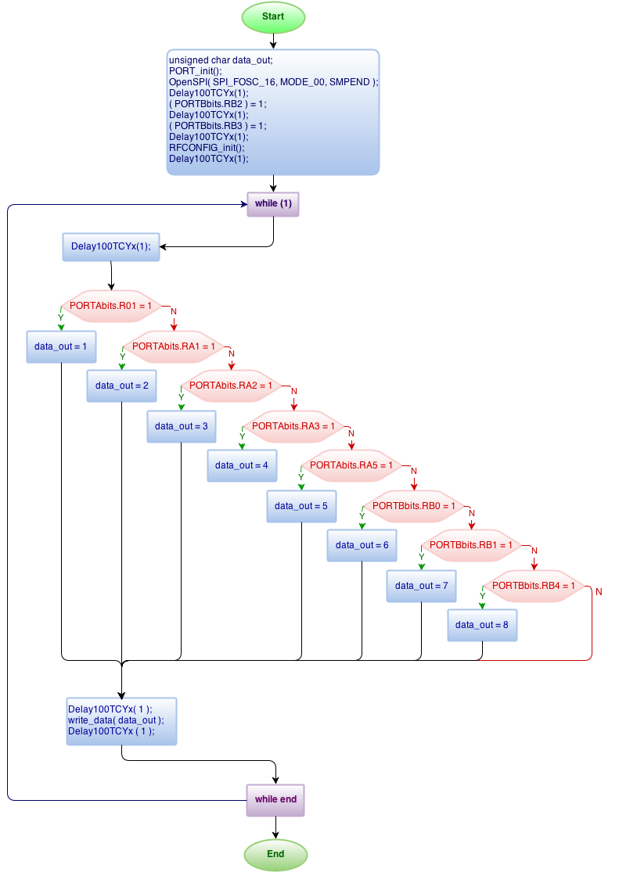
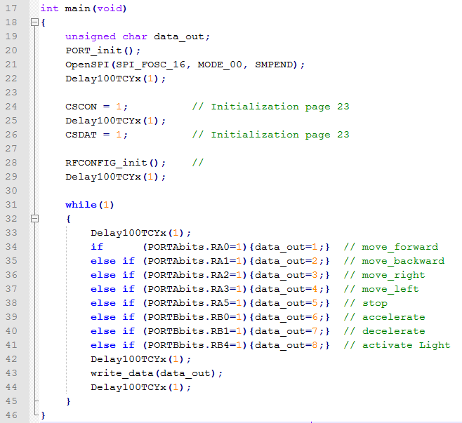

Slide 33
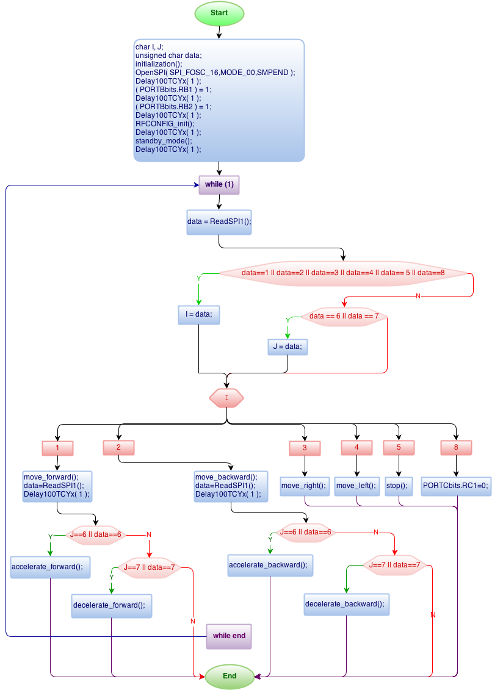
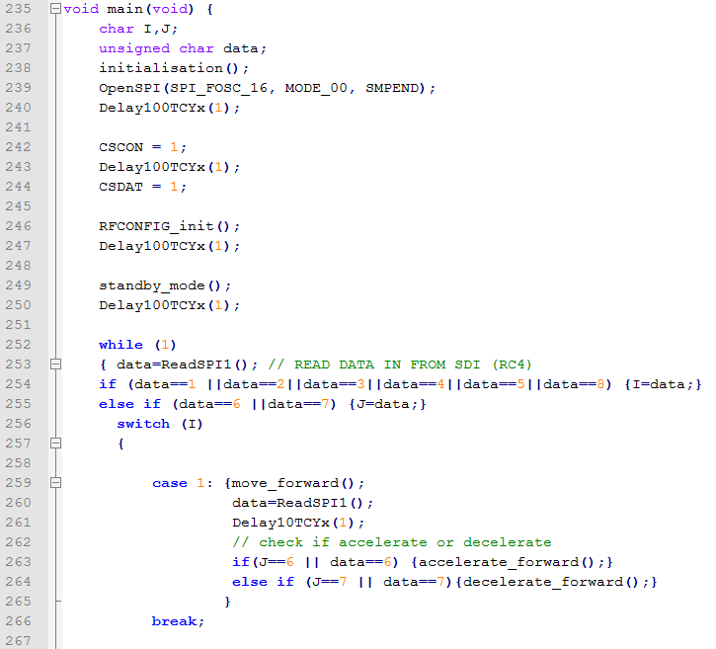
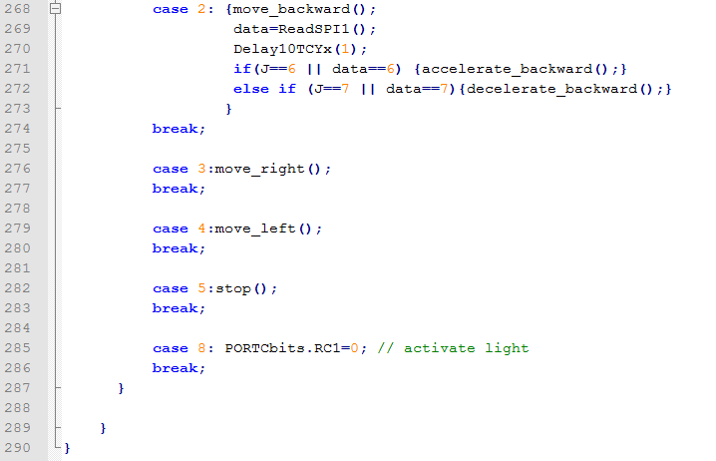

Slide 34
Current Issues
Software Issues
Developing GUI, computer application
Learning TCP/IP Protocols
Parts still shipping
Long lead times
Mechanical Issues

Slide 35
Budget
Item | Manufacturer | Unit Price | Ordered | Price
PIC18F46J13 I/PT | DigiKey | $4.16 | 3 | $12.48
PIC18F25J10 I/SP | Microchip | $1.99 | 3 | $5.97
MRF89XAM9A | Newark | $8.82 | 3 | $26.46
Xtal 20MHz | Sparkfun | $0.95 | 4 | $3.80
Microchip PICKit 3 | Microchip | $44.95 | 1 | $44.95
UA7805CKCS | TI | $0.49 | 10 | $4.90
LM1117T-3.3/NOPB | TI | $1.44 | 5 | $7.20
Pitsco TETRIX 12-Volt Rechargeable NiMH Battery Pack and Charger | Pitsco | $84.90 | 1 | $84.90
1N4001 | TTL Components | $0.49 | 10 | $4.90
22 pF capacitor (30pk) | Amico | $2.43 | 1 | $2.43
EasyN Wireless WIFI IP Camera | EasyN | $46.67 | 1 | $46.67
Walker | N/A | $50.00 | 1 | $50.00
DC Motor | Sears | $23.42 | 2 | $46.84
RN171 | Microchip | $28.75 | 1 | $28.75
L293D | TI | $2.50 | 3 | $7.50
Adidtional Small Parts |  | $100.00 | 1 | $100.00
Total |  |  |  | $477.75

Slide 36
Overall Progress

Slide 37
Questions?

